Slide 1



Smart Medical Equipment for Cronic Disease Detection

Slide 2

Preparation :
Mohamed Khaled Shaban (Team leader) 20-00817
Omnia Gad elkareem fathy 20-00685
Ghaada Ezzeldin Ali 20-00683
Dalia Khaled Abd-Eltwap 20-00524
Patric Emel Rezk 20-00879
Keroles Nasr Shafek 20-00861
Abdo Mohamed Abdo 20-00836
2

Slide 3
Supervised By: Dr/ Safi Ibrahim Eng/ Salma Montaser
3

Slide 4

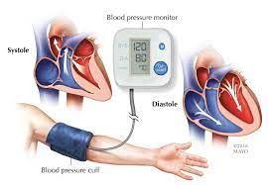
Abstract:
Today we are creating an Android application that measures pressure and heart rate through two sensors, one for pressure and the other for heart rate. The application takes those readings and compares them with the data that we entered previously.
4

Slide 5


Table Of Contents
01
06
Related Work
11
UI
Introduction
02
Goal of the project
07
Prototype
12
Backend
03
Problem Statement
08
Hardware
04
Features
09
Datasets
05
Implementation tools
10
AI model
5

Slide 6


Introduction:
Nursing profession is considered one of the noble and humanitarian professions. Those working in this profession are often referred to as "angels of mercy" because of their association with human health, the protection of life, and the alleviation of pain and suffering.
This is due to the compassionate role they play in various stages of treatment from a medical perspective.
6

Slide 7

Introduction:
Nursing profession has evolved to keep pace with scientific, cultural, and technological advancements in the field of healthcare. It has also played a crucial role in educating the community about disease prevention. As a result, nursing has become a profession with various specializations and diverse roles in providing healthcare and assistance to individuals and communities.
7

Slide 8


Goals of the project :
Facilitating Blood pressure measurement.
Facilitating Heart rate measurement.
Enhancing Health care.
Patient Safety Enhancement.
"The project helps facilitate communication between medical staff and patients, contributing to original collaboration and consequently, the smooth exchange of information.
It enables easy access to the Health Information Management department for patients, including medical records and reports.
Some applications aim to improve treatment processes, either by providing tools for monitoring medical conditions."
8

Slide 9

Problem Statement:
"Individuals may neglect their health, and symptoms that may seem minor can be early indicators of serious illnesses. An application can enable them to prioritize their health and make it easier for them .“
"We find that the world is filled with diseases such as diabetes, hypertension, and heart issues, and these diseases are often discovered in later stages."
9

Slide 10

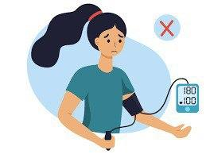
Problem Statement:
In some cases, blood pressure may have a problem with an individual's ability to perform certain tasks.
The doctor reviews the health condition and follows a healthy lifestyle so that he can help control these matters and quality of life.
10

Slide 11

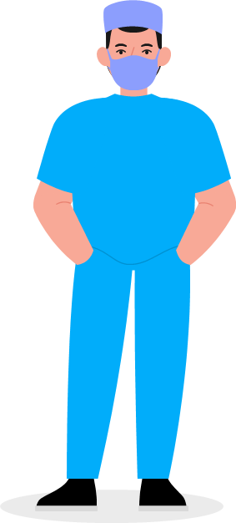
Features:
. Health Information Record: App can record personal health data such as blood pressure, heart rate, blood sugar levels, and more.
. Health Tips: May provide health tips and guidance based on recorded data, helping improve lifestyle. . Medication and Appointment Reminders: Can remind users of medication times and important medical appointments. . Data Privacy: Many personal nursing apps are committed to protecting user privacy and health data.
11

Slide 12

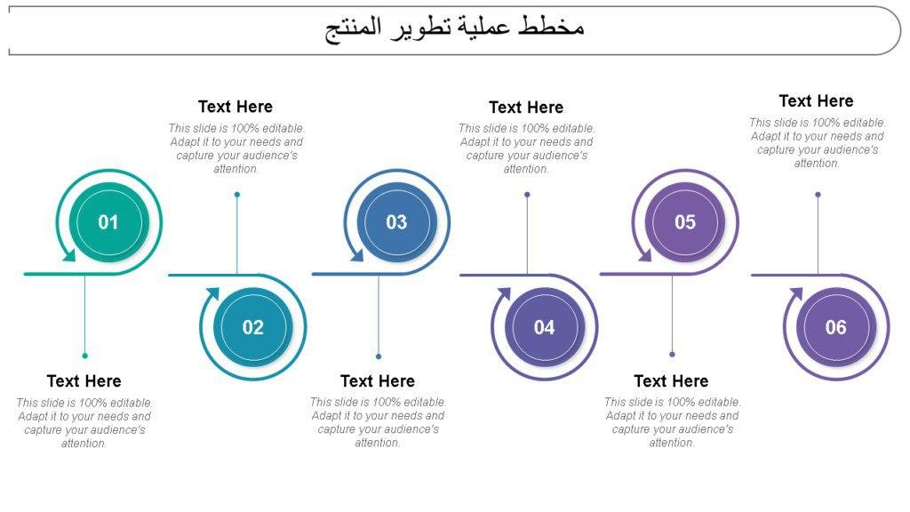

Implementation tools:
FLUTER
Android Studio
Visual studio
Datasets
MySQL
Colab
AI
API
Programming Language
API Documentation
Colab for coding
SVM model
12

Slide 13

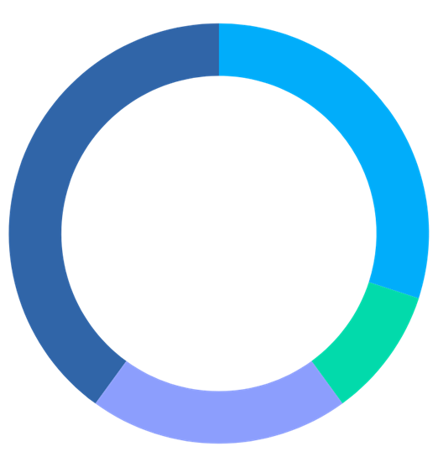
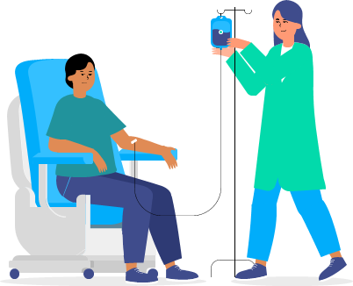
Related Work:
There are many previous works that focused on detecting diseases, such as the “Symptomate” website, and this site had an important role in diagnosing diseases, but this site did not pay attention to some important things that facilitate the patient’s treatment journey, such as measuring blood pressure, measuring heartbeat, and alerting the disease to the date of treatment;
Therefore, our application came to complement some of the shortcomings in previous works that facilitate the process of recovery from diseases for the patient.
13

Slide 14
Related Work:
Our application measures blood pressure and heart rate through sensors specially designed for measurement.
There is also a calendar and alarm inside the application to help the patient remember the date of treatment and also the dates of medical examinations.
14

Slide 15
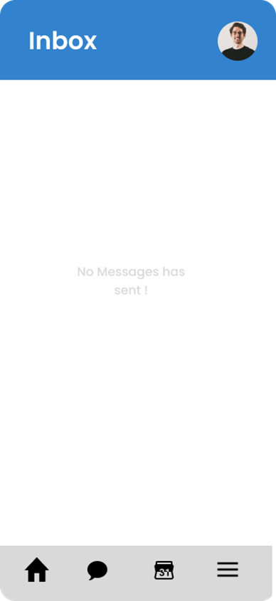
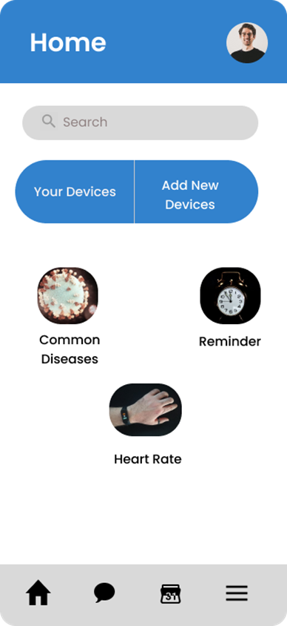



Prototype:
15

Slide 16
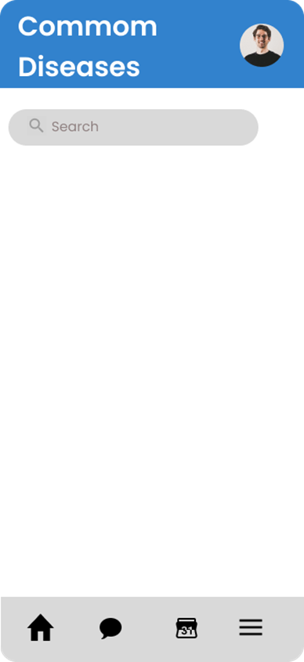
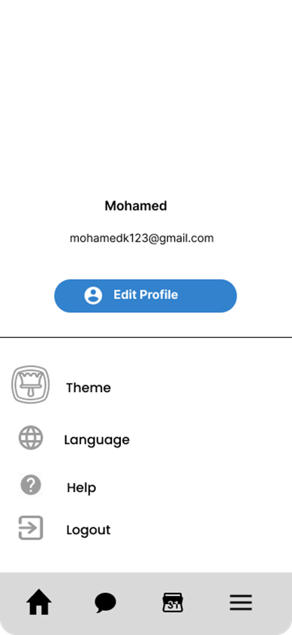
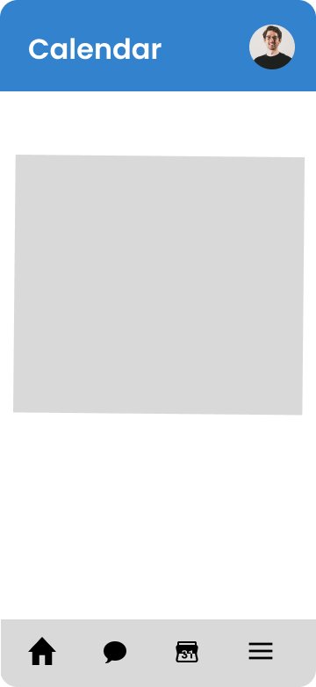

16

Slide 17
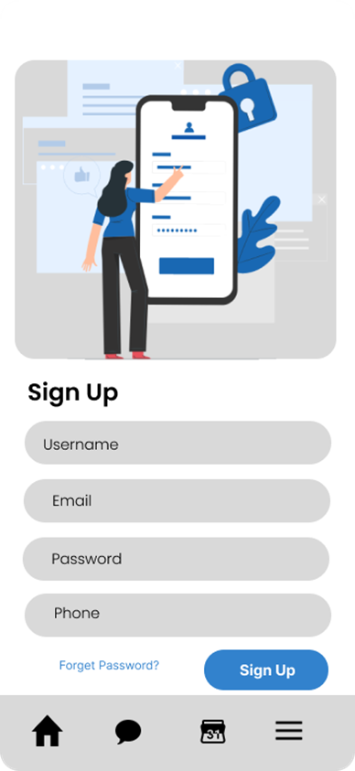
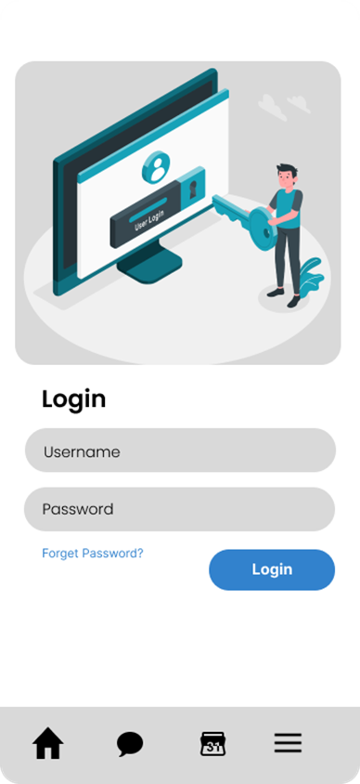
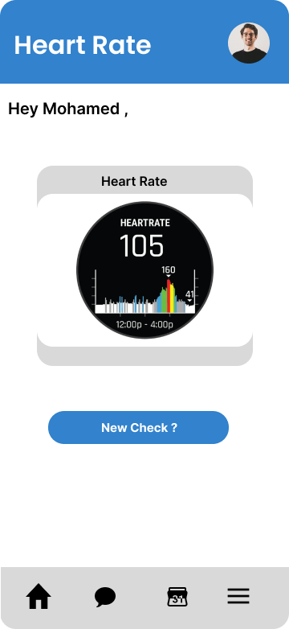

17

Slide 18
Hardware:
For simulating a heart rate sensor using Proteus with Arduino IDE, you'll need the following components:
Heart Rate Sensor:
Heartbeat sensor
Arduino Uno
LCD (green)
Button
Connection: Connect the heart rate sensor and button to Arduino Uno. Connect the LCD to Arduino Uno to display heart rate readings.
Upload the Arduino IDE code in Proteus to obtain heart rate readings on the LCD and Serial Monitor.
18

Slide 19
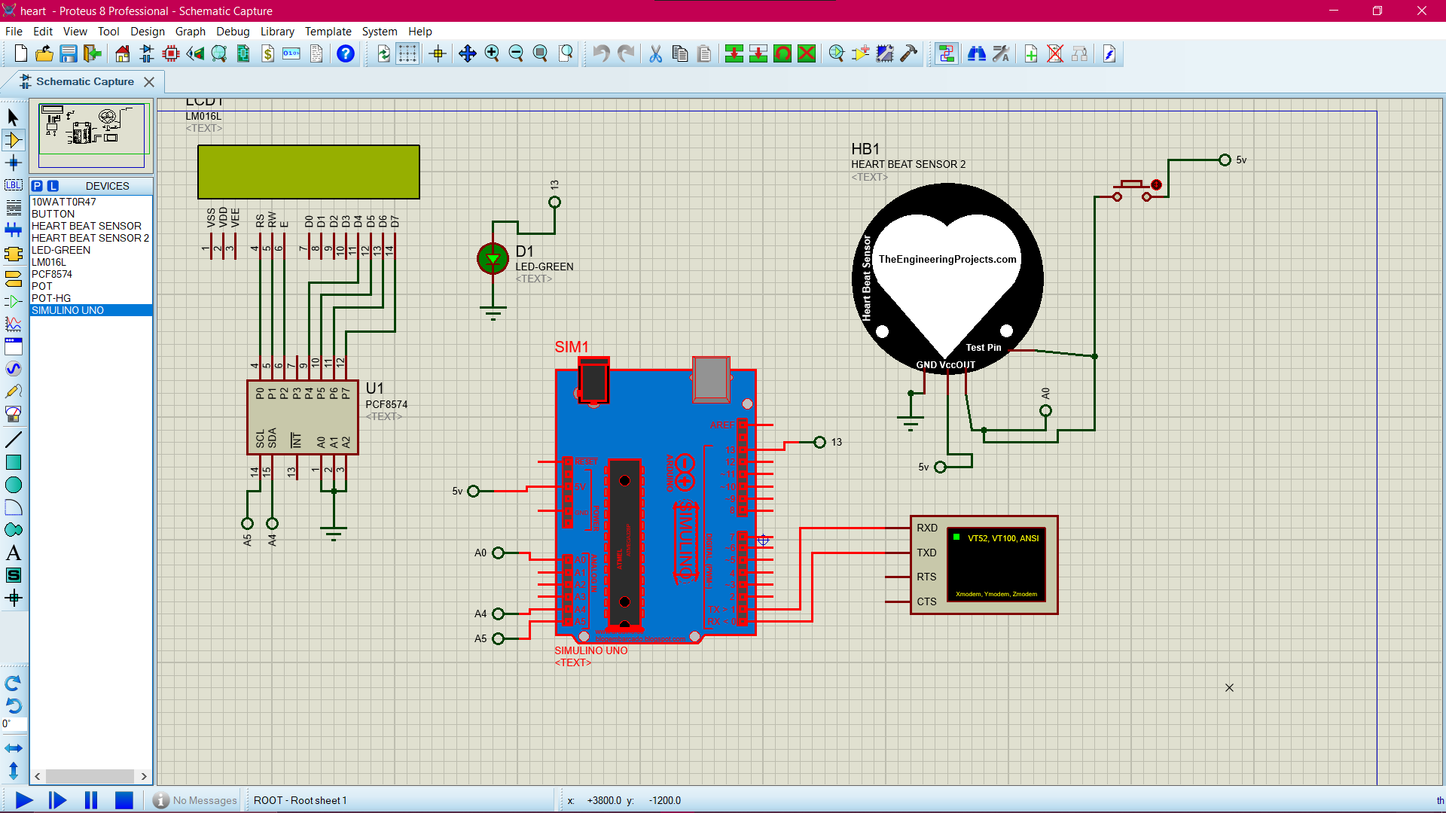
Hardware:
(1)
19

Slide 20
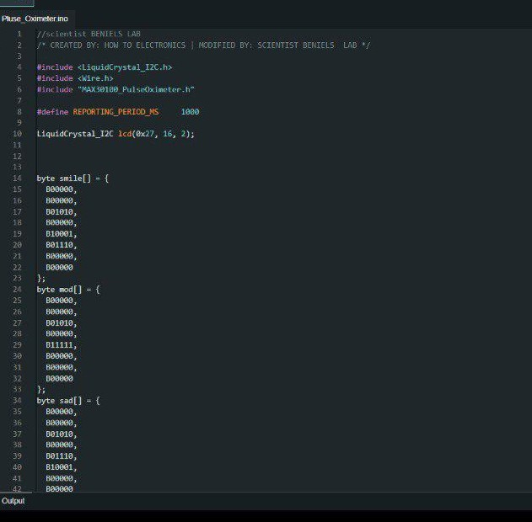
Hardware:
(2)
20

Slide 21
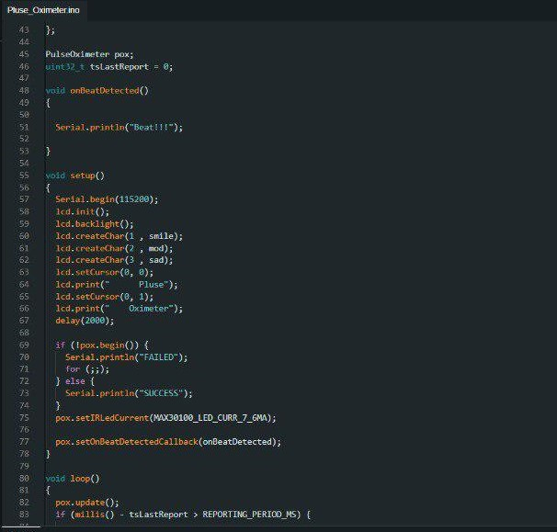
Hardware:
(3)
21

Slide 22
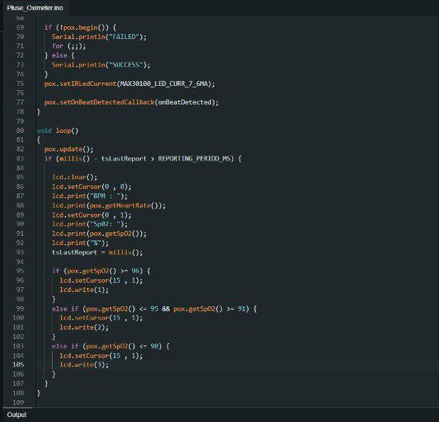
Hardware:
(4)
22

Slide 23
Hardware:
To simulate a blood pressure sensor using the Proteus software with Arduino IDE, you need the following components:
Blood Pressure Sensor:
Mpx4115 pressure sensor
Arduino Uno
Connection:
Connect the blood pressure sensor to the Arduino Uno in Proteus.
Upload the Arduino IDE code in Proteus to obtain blood pressure readings in the Serial.
23

Slide 24
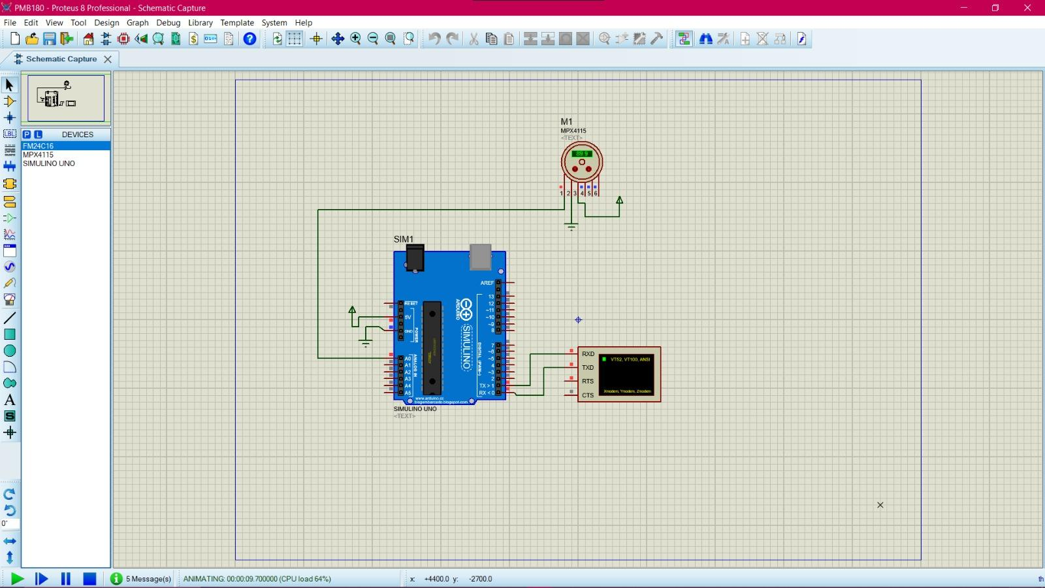
Hardware:
(5)
24

Slide 25
Datasets:
The normal pulse for healthy adults ranges from 60 to 100 beats per minute. The pulse rate may fluctuate and increase with exercise, illness, injury, and emotions. Females ages 12 and older, in general, tend to have faster heart rates than do males.
abnormality of the heart's rhythm. It may beat too slowly, too quickly, or irregularly.
These abnormalities range from a minor inconvenience or discomfort to a potentially fatal problem and if that occurs should go to the doctor and he can distinguish if it's regular or irregular dysrhythmia.
25

Slide 26
Datasets:
We are collecting data for heart rate and blood pressure. The heart rate data is 300 KB with 11 columns and 8000 rows, including information like age, gender, cholesterol levels, smoking status, history of heart problems, etc. The blood pressure data is 740 KB with 12 columns and 13000 rows, including age, gender, weight, systolic and diastolic pressure, grip strength, etc.
I performed cleaning for the heart rate data, extracting relevant information, and reprocessing using libraries such as numpy, pandas, and we used pandas library to upload dataset file (csv) Example. Similarly, you conducted cleaning for the blood pressure data, extracted relevant details,
and reprocessed it using the mentioned libraries, with data uploaded through colab, then we took a step further in processing the dataset as we defined a function “classify_blood_pressure” that takes the attribute (systolic, diastolic) to help us to categorize the value of blood pressure (systolic and diastolic values) .
26

Slide 27
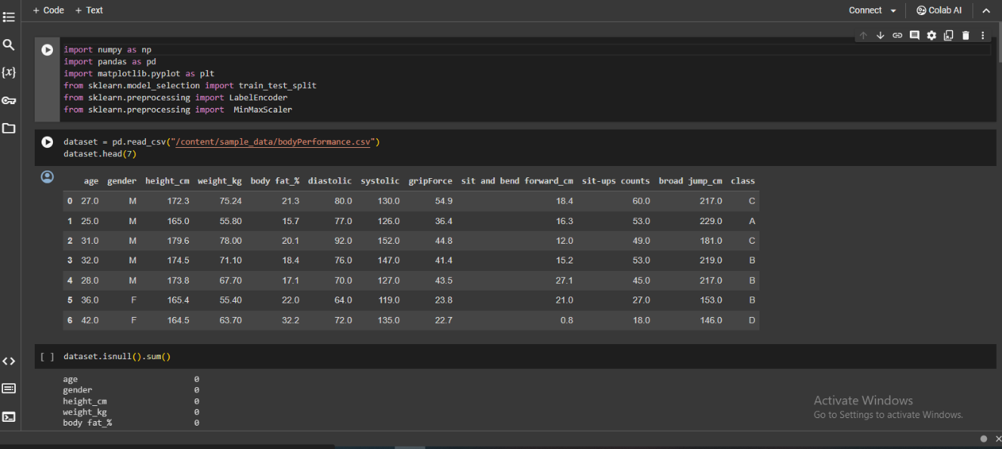
Datasets:
(6)
27

Slide 28
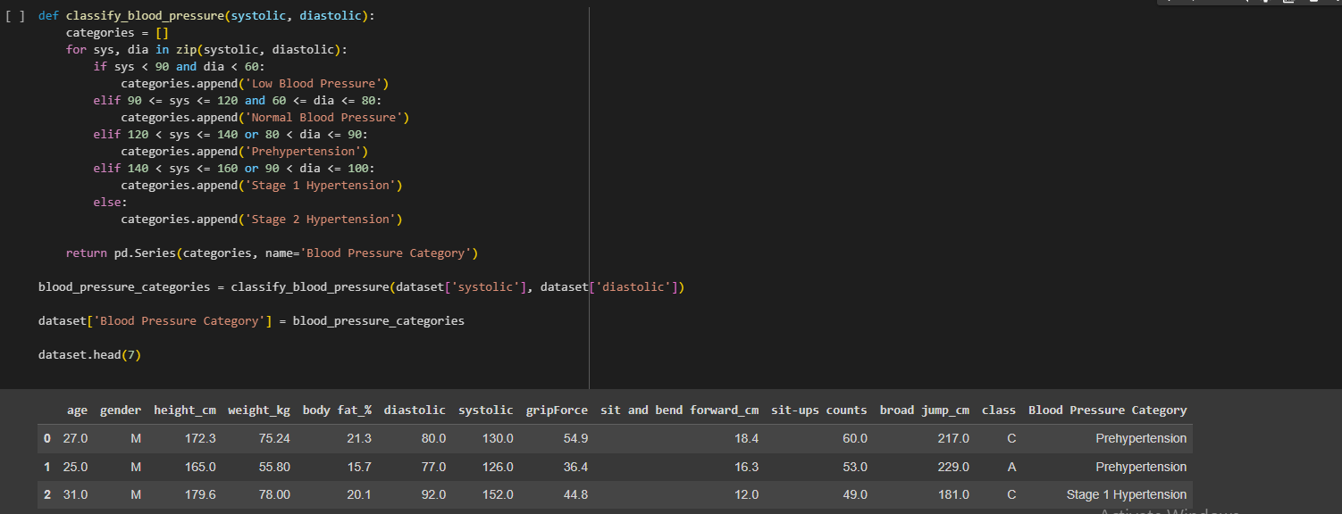
Datasets:
(7)
28

Slide 29
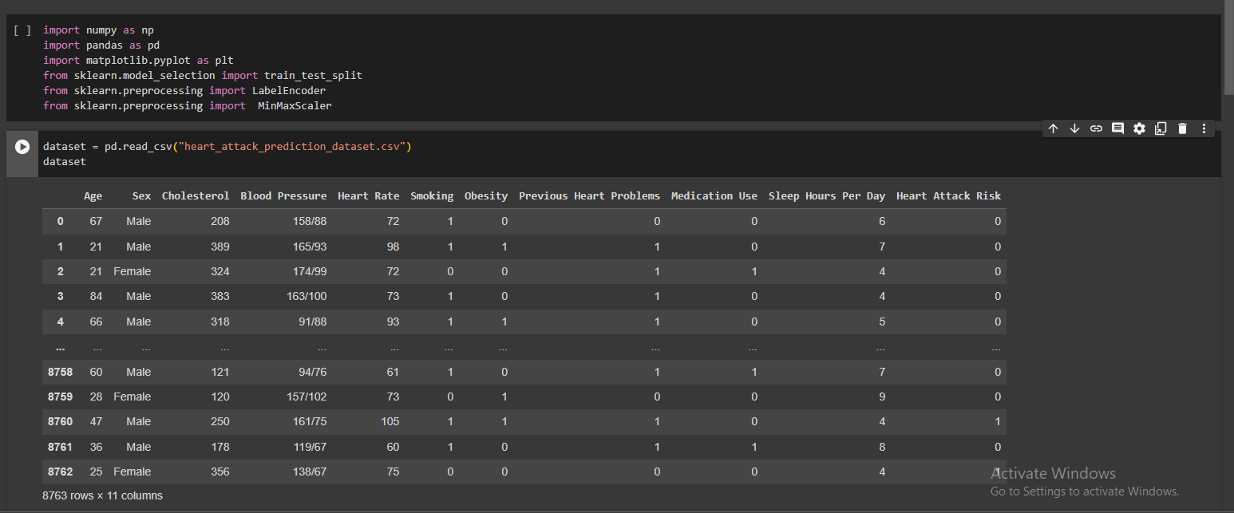
Datasets:
Heart Rate
(8)
29

Slide 30
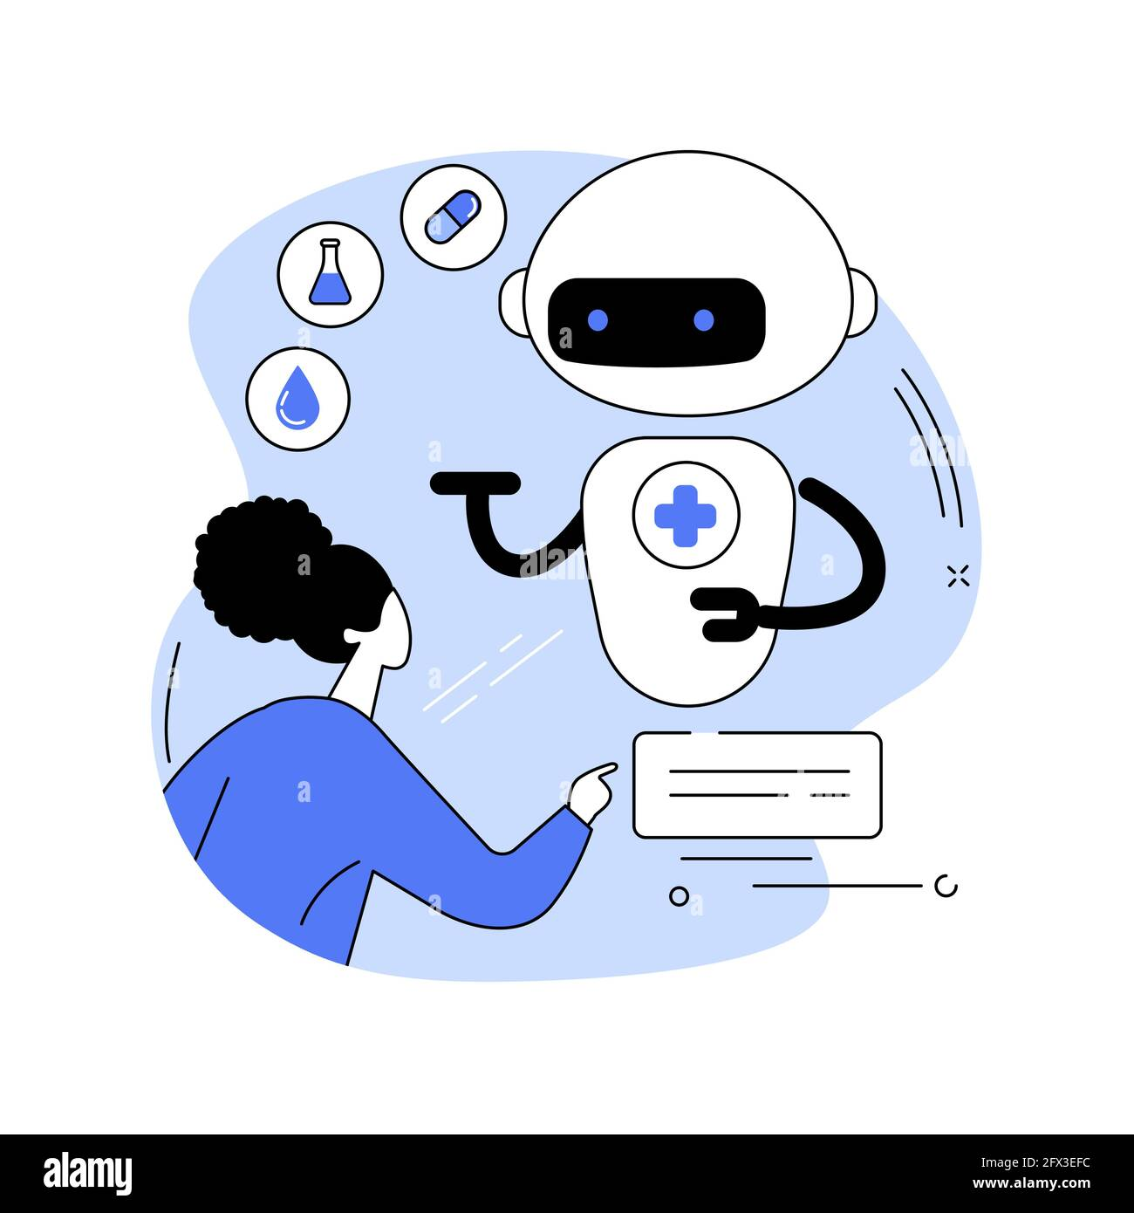
AI model:
In this project we are using Support Vector Machine model that depends on the supervised algorithm .
Due to the nature of our application, The available data, The desired outcome from the application and The trials and Tests , We favored the Classification algorithm over the Clustering algorithm .
The SVM model is widely used and the most efficient in the development of the third generation medical applications .
30

Slide 31
AI model: SVM
Advantages & Disadvantages
Advantages:
1) It can handle high-dimensional and nonlinear data, which makes it suitable for complex problems.
2) It can perform well with small datasets, as it only requires a few support vectors to define the boundary.
Disadvantage:
1) It can be sensitive to the choice of kernel, which determines how the data is transformed into a higher-dimensional space.
31

Slide 32
AI model: Blood Pressure
The Blood Pressure Model (K-means)
After acquiring the cleaned and preprocessed data from the DBMS team , we started by what is called the ( Elbow Method ) to define the number of clusters that w will be using , we started the code by assigning (sse)which is an empty list then we determined the range from 1 to 11 and stored the range in variable (k_range) , then we made a for loop to make sure that the k which is the variable for the number of clusters runs over the desired range , then we fit the loop to the columns of “diastolic , systolic “ after thet we append the data to the empty list which we previously introduced with the “inertia_” which calculate the square error.
32

Slide 33
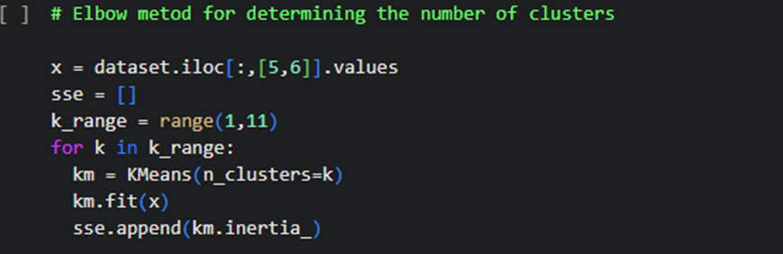
AI model:
(9)
33

Slide 34
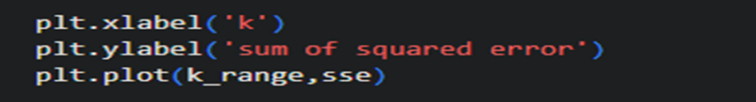
AI model:
We then used the matplotlib which we imported previously as plt , so that the model can generate a graph to help use visualize the data on that graph ,the we determined the x label and the y label on the graph .
(10)
34

Slide 35
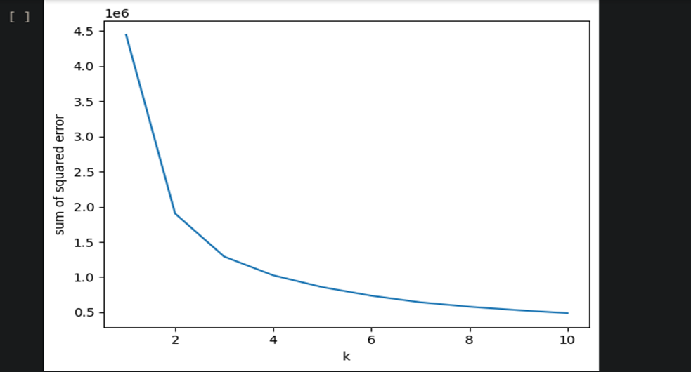
AI model:
(11)
35

Slide 36
AI model:
From the graph above we concluded that that there will be 4 clusters , then we fit the data with the 3 clusters , the we created a new column in the data table which we called it “clusters” that was given the values of the result of the predicted clusters .
36

Slide 37
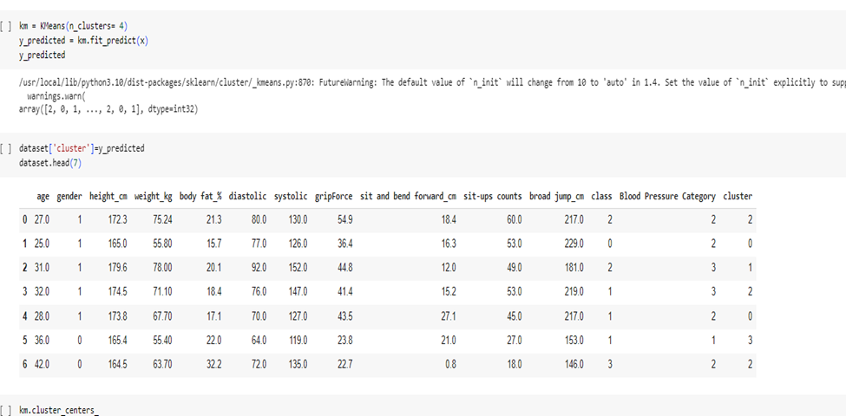
AI model:
Fig(4)
37

Slide 38
AI model:
Then we prepared the scatter plot by assigning each cluster to a specific color so that we can differentiate between them on the plot , the we determined the x label and the y label on the plot .
38

Slide 39
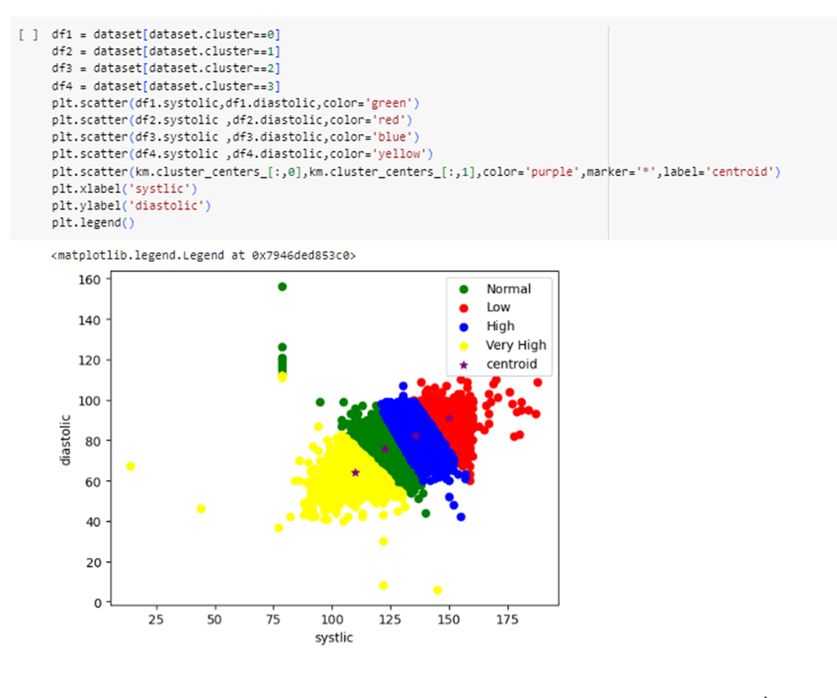
AI model:
(12)
39

Slide 40
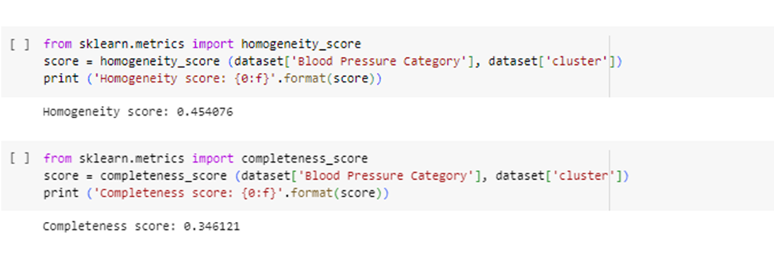
AI model:
We have calculated its value Accuracy
(13) : calculation for the accuracy percentage of the K-Means.
40

Slide 41
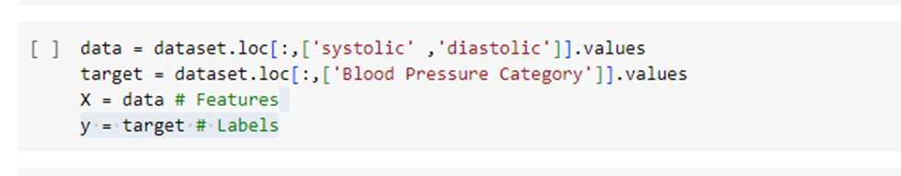
AI model:
Support Vector Machine
After acquiring the cleaned and preprocessed data from the DBMS team , we started by support vector machine we fit the loop to the columns of “diastolic , systolic “and the target “ Blood Pressure Category”
(14)
41

Slide 42
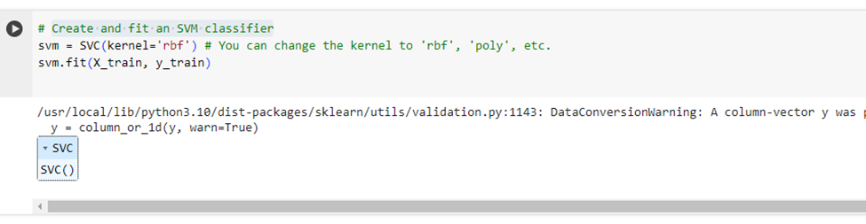
AI model:
We use SVMs for linear classification purposes. In addition to performing linear classification, we also use the kernel trick. It enables us to map inputs implicitly into high-dimensional feature spaces.
(15)
42

Slide 43
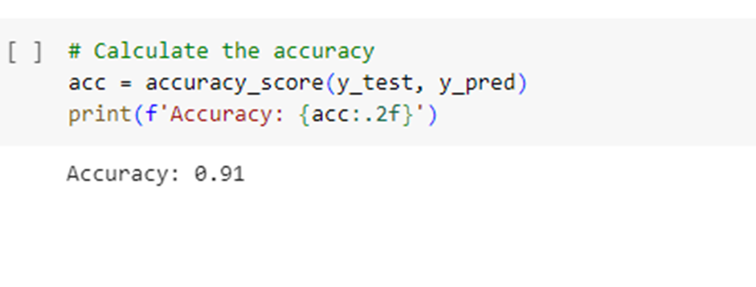
AI model:
We have calculated its value Accuracy.
(16) : calculation for the accuracy percentage of the SVM.
43

Slide 44
AI model: Heart Rate
Heart Rate Model(K-Means)
After getting the cleaned and pre-processed data from the DBMS team, we started with what is called (elbow method) to determine the number of groups we will use. We started the code by setting (wbd), which is an empty list. We defined the range from 1 to 11 and stored the range in the variable (k_range), then we make a for loop to make sure that k, which is the variable for the number of clusters, spans the desired range.
We then fit the loop to the Heart Rate and Heart Attack Risk columns. We then append the data to the empty list we provided earlier with “inertia,” which calculates the squared error.
44

Slide 45
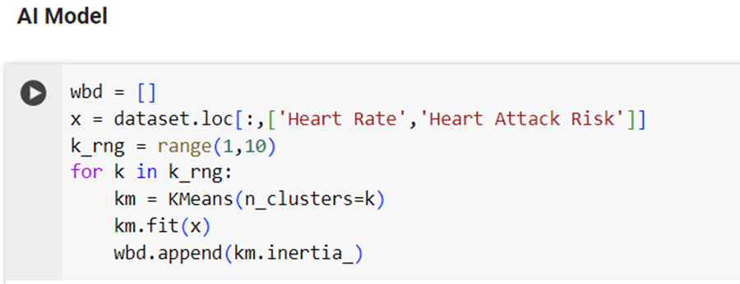
AI model:
(17)
45

Slide 46
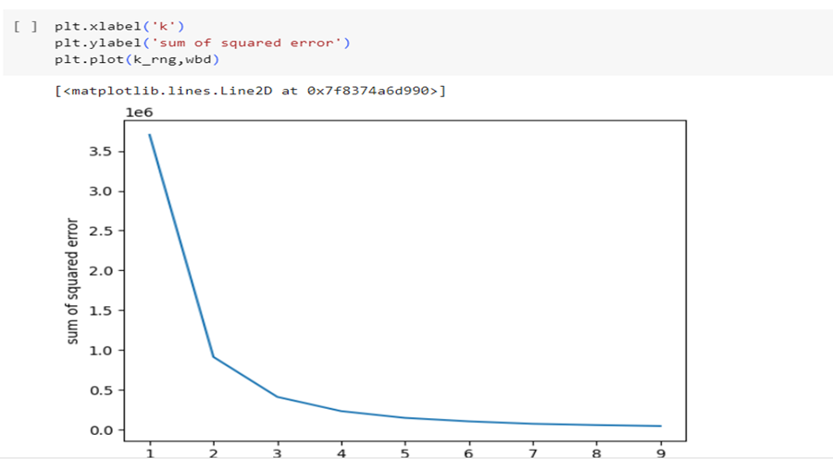
AI model:
We then used the matplotlib which we imported previously as plt , so that the model can generate a graph to help use visualize the data on that graph ,the we determined the x label and the y label on the graph .
(18)
46

Slide 47
AI model:
From the graph above we concluded that that there will be 3 clusters , then we fit the data with the 3 clusters , the we created a new column in the data table which we called it “clusters” that was given the values of the result of the predicted clusters .
47

Slide 48
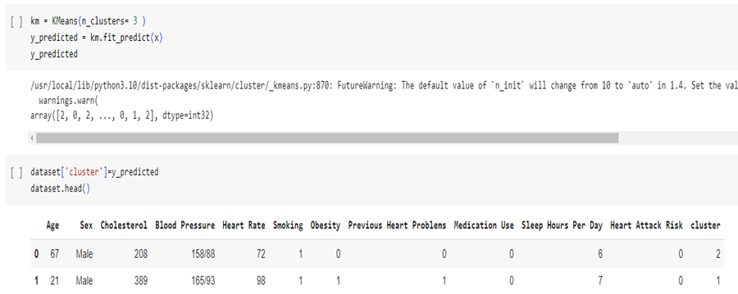
AI model:
(19)
48

Slide 49
AI model:
Then we prepared the scatter plot by assigning each cluster to a specific color so that we can differentiate between them on the plot , the we determined the x label and the y label on the plot .
49

Slide 50
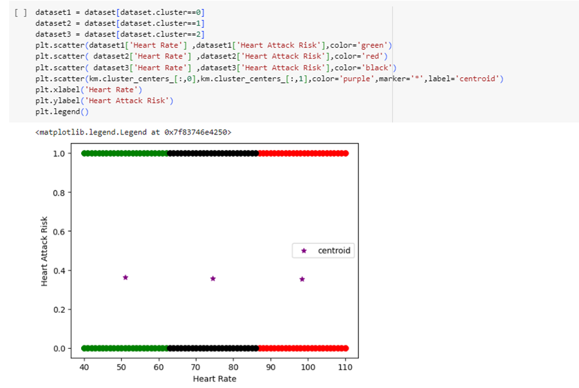
AI model:
(20)
50

Slide 51
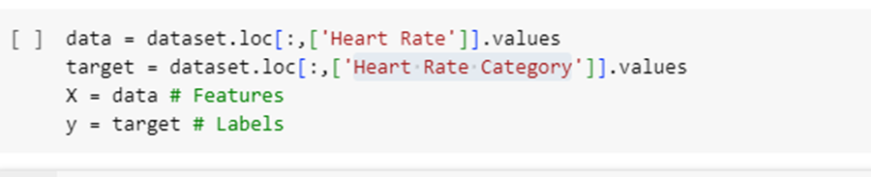
AI model:
Support Vector Machine
After acquiring the cleaned and preprocessed data from the DBMS team , we started by support vector machine we fit the loop to the columns of Heart Rate and the target Heart Rate Category.
(21)
51

Slide 52
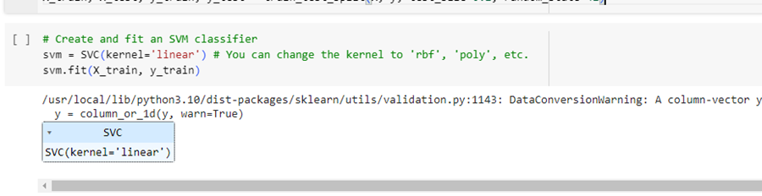
AI model:
We use SVMs for linear classification purposes. In addition to performing linear classification, we also use the kernel trick. It enables us to map inputs implicitly into high-dimensional feature spaces.
(22)
52

Slide 53
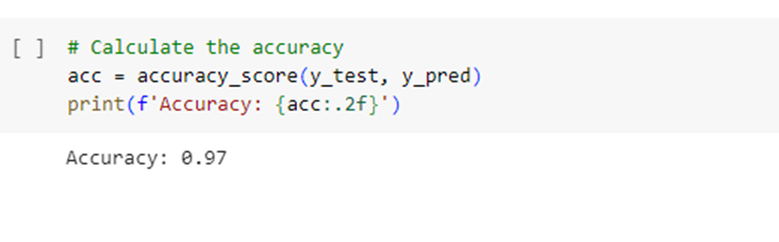
AI model:
We have calculated its value Accuracy .
(23) : calculation for the accuracy percentage of the SVM.
53

Slide 54

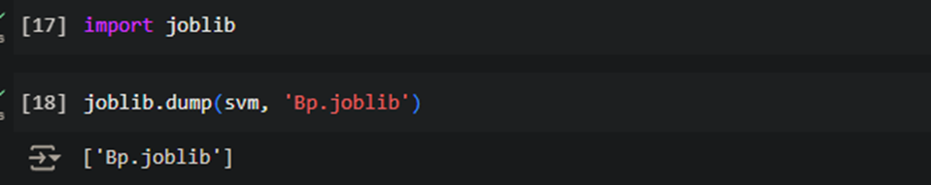
AI model:
After comparing the accuracies between the k means and the SVM models , We chose the SVM model due to the high accuracy score .
So we used the joblib library in order to save the bloode pressure model , then we stored our model in a file which we named “BP.joblib” by using then dump function .
(24)
54

Slide 55
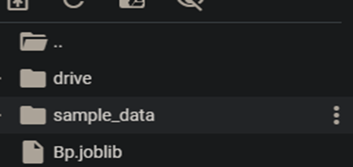
AI model:
After all that we faced a problem ,
As many platforms that are used for integrating the models with mobile applications doesn’t support machine learning models , So we had to convert the archeticture of the model to be compitable with the platforms ,
Hinse we are using an SVM model that was designed with sklearn library , we decided to convert it to ONNX (Open Neural Network Exchange) format which is supported by many mobile platforms .
This way was more efficient and saves a lot time ,resources and money ,
Rather than redesigning the whole architecture of the SVM model using Keras library so we could convert it to tenserflow or tenserflow lite so that it would be compitable with mobile platforms .
So we started making sure that the skl2onnx is installed.
(25)
55

Slide 56
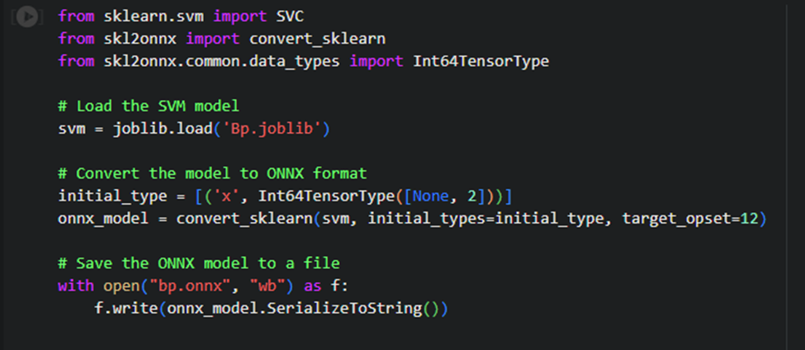
AI model:
We first loaded the saved model by using the load funcion ,
Then we used the convert_sklearn function to convert the model to ONNX format ,
After that we saved ower model in file that we named “bp.onnx”.
(26)
56

Slide 57
AI model:
We first loaded the saved model by using the load funcion ,
Then we used the convert_sklearn function to convert the model to ONNX format ,
After that we saved ower model in file that we named “bp.onnx”.
(27)
57

Slide 58
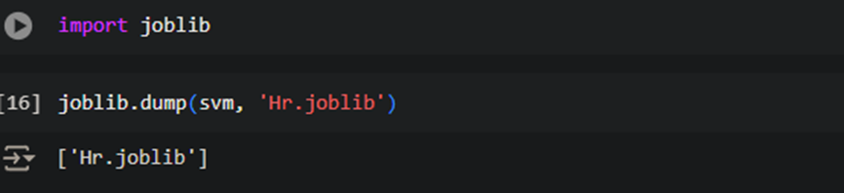
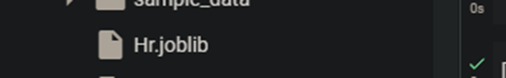
AI model:
We did the same steps with the heart rate model with some little differences ,
We used the joblib library to save the heart rate model same as bloode pressure but this time we saved the model in a file named “Hr.joblib” by also using the dump function.
We also made sure that the skl2onnx library was installed ,
(28)
58

Slide 59
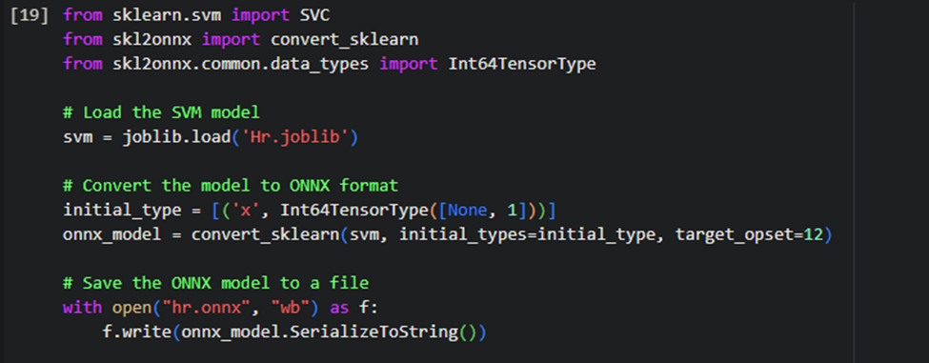
AI model:
Then we loaded the model , then converted it as same as what we did with the blood pressure model ,
Then we saved it in a file we named “hr.onnx” .
(29)
59

Slide 60
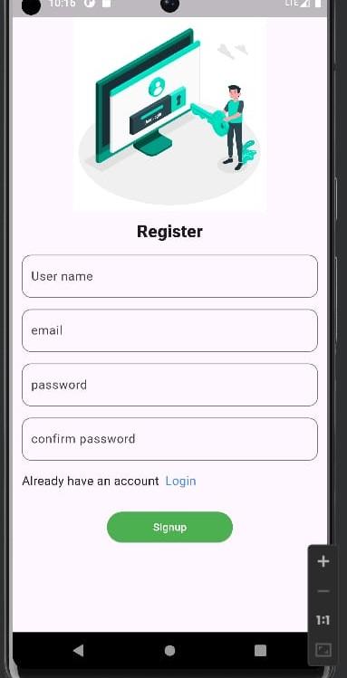

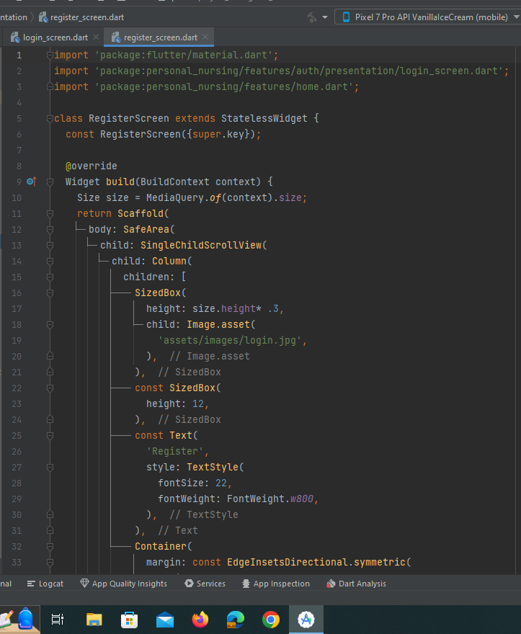
UI:
(31)
60

Slide 61
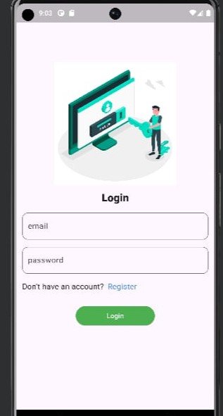
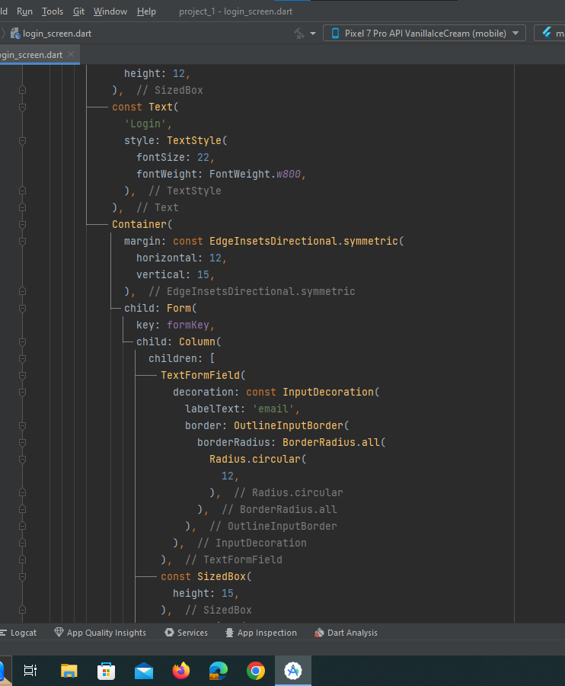
UI:
(32)
61

Slide 62
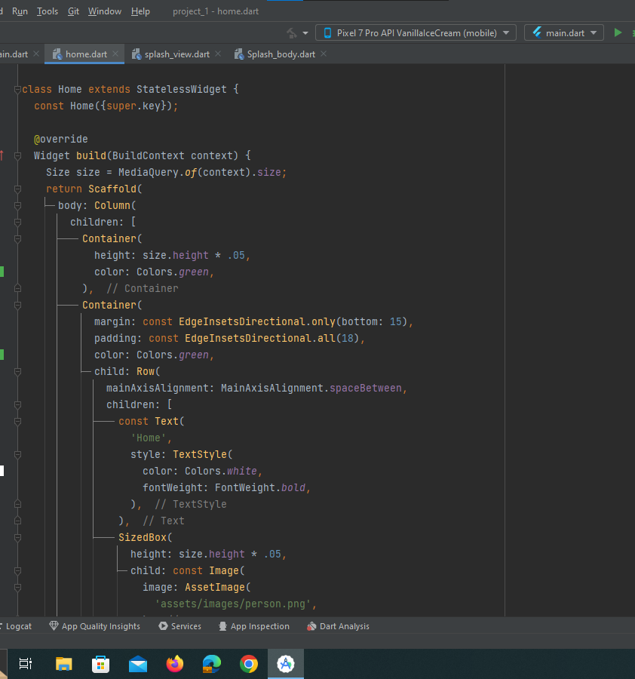

UI:
(33)
62

Slide 63

UI:
(34)
63

Slide 64


UI:
(35)
64

Slide 65

API:
(36)
65

Slide 66

API:
(37)
66

Slide 67

API:
(38)
67

Slide 68
API:
This code creates a web application using Flask to provide two APIs for predicting blood pressure and heart rate categories using pre-trained machine learning models. Key Components:
1.Libraries and Initialization: Imports Flask, CORS,numpy, and joblib..Initializes the Flask app and enables CORS for cross-origin requests. 2.Loading Models: Loads pre-trained SVM models for blood pressure (svm_model_bp) and heart rate (svm_model_hr) predictions using joblib. 3.Defining Categories: Defines dictionaries and lists to map model outputs to human-readable categories for blood pressure and heart rate. 4.Endpoints: /predict_blood_pressure: Accepts POST requests with form data (systolic and diastolic values), predicts the blood pressure category, and returns the result as JSON../predict_heart_rate: Accepts POST requests with JSON data (heart rate), predicts the heart rate category, and returns the result as JSON. It includes error handling for missing or invalid data.
68

Slide 69
API:
Apps:
Runs the Flask app in debug mode, accessible from any network interface. 6.Example Usage:
1.Blood Pressure Prediction:Send a POST request with systolic and diastolic values to /predict_blood_pressure and receive the predicted category. 2.Heart Rate Prediction:Send a POST request with heart rate value to /predict_heart_rate and receive the predicted category.
69

Slide 70

Back-end:
-Explaine changes in the authentication state using Firebase , in a Flutter application. When the authentication state changes, it prints a message indicating whether a user is signed in or signed out, and then runs the app.
-Helps the user for identity changes, method returns a stream of user states, which triggers every time there is a change in the user's sign-in state.
(39)
70

Slide 71

Back-end:
Firebase Options for each supported platform (web, android,ios,macos, windows).
(40)
71

Slide 72

Back-end:
Each platform (web, android, IOS, MACOS, windows) has a Firebase Options configuration which includes parameters like api Key, authDomain, projectId, storageBucket, messagingSenderId, appId, and for web measurementId.
(41)
72

Slide 73

Back-end:
heart-Rate: update and retrieve the heart rate, takes a user Id and a heart-Rate as parameters and updates the document in the users collection with the given user Id, It sets the heart-Rate and last Updated ,and We used another Field to record the timestamp of the update, If happen error occurs during the update, it catches the exception and prints an error message.
(42)
73

Slide 74

Back-end:
(43)
74

Slide 75

Back-end:
(44)
75

Slide 76

Back-end:
(45)
76

Slide 77
Conclusion:
Finally, our greatest goal is to help patients in their treatment journey and make it easier for them through what we have provided for them.
“At the end of the day people won't remember what you said or did, they will remember how you made them feel.”
― Maya Angelou
77

Slide 78
References:
https://www.figma.com/
https://www.udemy.com/course/arduinoworkshop/
https://www.kaggle.com/datasets/kukuroo3/body-performance-data
https://www.kaggle.com/datasets/iamsouravbanerjee/heart-attack-prediction-dataset
https://youtu.be/PkNXikwsg7s?si=37iVYKUSA71turtR
https://youtu.be/hseubRb12J4?si=BT-Nz2LHHczhcDCW
https://youtu.be/6iRQGvPhoXc?si=vqG7_B6-yfyCA0wc
https://roboticsbiz.com/pros-and-cons-of-support-vector-machine-svm/
https://www.geeksforgeeks.org/support-vector-machine-algorithm/
78

Slide 79


Thank You

